Slide 1





CSI Presentation – 2nd Year of Ph.D. Thesis
Phase Field Modeling of Fracture in Geomaterials by Considering the Hydromechanical Coupling
Xiaodong ZHANG
Supervisor: Albert GIRAUD
External tutor: Djimédo KONDO
Co-supervisor: Long CHENG
03/09/2021

Slide 2
Introduction
01
Phase field modeling of brittle fracture
02
OUTLINE
Phase field modeling of fracture by considering the hydromechanical coupling
03
Conclusions and perspectives
04

Slide 3
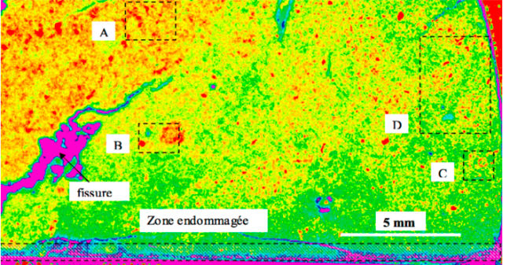
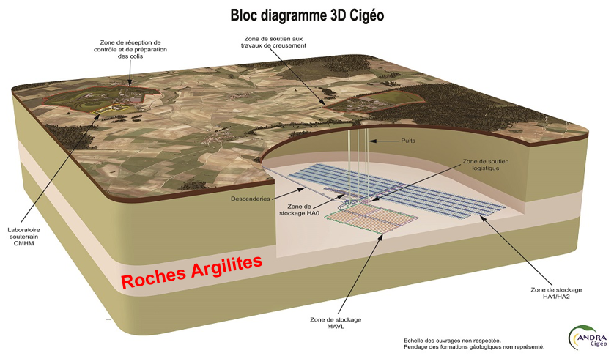
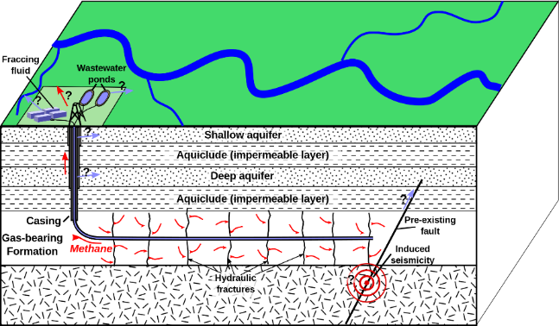
Introduction: Background
Fracture (Robinet 2006)
Geological engineering
Hydraulicfracture

Slide 4
Introduction: History of brittle fracture and phase field modeling
Alessi et al. 2014
Brach et al. 2019
Bourdin et al.
2000,2008
Gradient damage models coupled with plasticity
A powerful tool of fracture in brittle materials
Francfort
and Marigo,1998
Ambrosio
and Tortorelli,1990
Miehe and Steffen,2014
A variational model of quasi-static crack evolution
Hydraulic fracture in poro-hydro-elastic media
Griffith,1921
Approximate Mumford‐Shah image segmentation functional by elliptic functionals defined on Sobolev spaces
Theoretical foundations of the classical theory of brittle fracture
1921
1990
1998
2000,2008

Slide 5

02
PART
Phase field modeling of brittle fracture

Slide 6
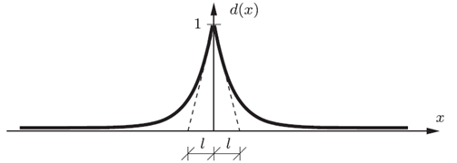
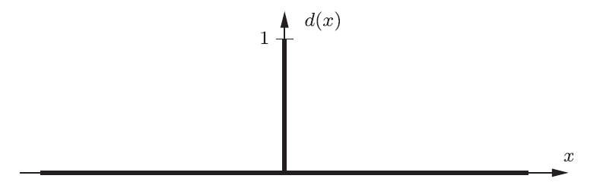
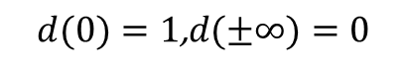
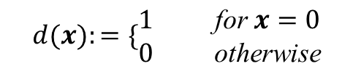
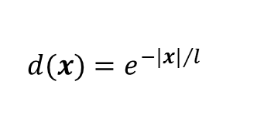
Description of phase field (Miehe et al. 2010)
Fully Broken
Unbroken
Fig.1 Sharp Crack Topology (Discontinuity)
Fig.2 Regularized Crack Topology (Continuity)
$$d(x)=e^{−|x|/l}$$
(2)
$$d(x):=\{\begin{matrix}1 & & \text{for} x=0 \\ 0 & & \text{otherwise}\end{matrix}$$
(1)
$$d(0)=1\text{,}d(±∞)=0$$
(3)

Slide 7
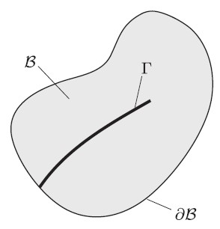
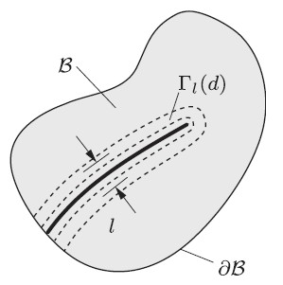
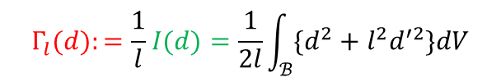
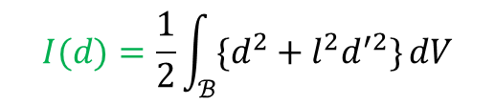
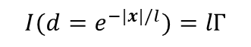
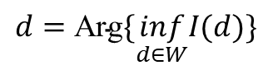


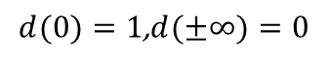
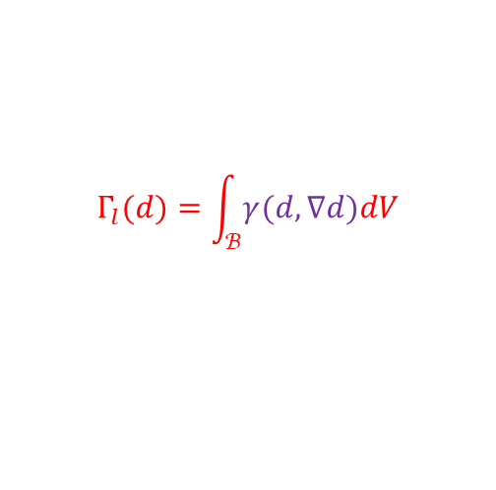
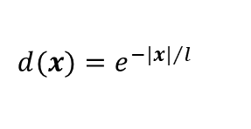
Representation of crack by phase field
$$d=\text{Arg}\{\inf_{d∈W}I(d)\}$$
(5)
$$d(0)=1\text{,}d(±∞)=0$$
(3)
$$I(d)=\frac{1}{2}\int_{ℬ}{\{d^{2}+l^{2}d^{′2}\}}dV$$
$$d(x)=e^{−|x|/l}$$
(2)
(6)
$$d\left(x\right)−l^{2}d^{′′}\left(x\right)=0$$
(4)
$$I(d=e^{−|x|/l})=lΓ$$
(7)
$$Γ_{l}(d):=\frac{1}{l}I(d)=\frac{1}{2l}\int_{ℬ}{\{d^{2}+l^{2}d^{′2}\}dV}$$
(8)
$$Γ_{l}(d)=\int_{ℬ}{γ(d,∇d)dV}$$
(9)
Fig.3 Sharp crack surface
Fig.4 Regularized crack surface
$$γ(d,∇d)=\frac{1}{2l}d^{2}+\frac{l}{2}{|∇d|}^{2}$$
(10)

Slide 8
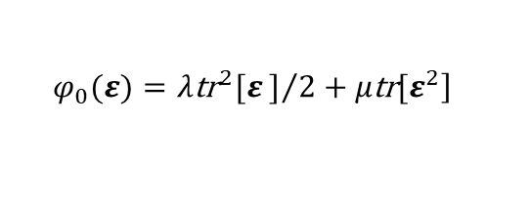
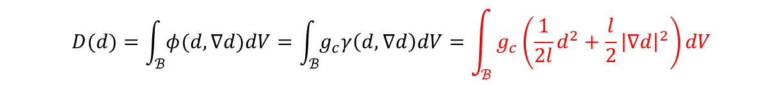
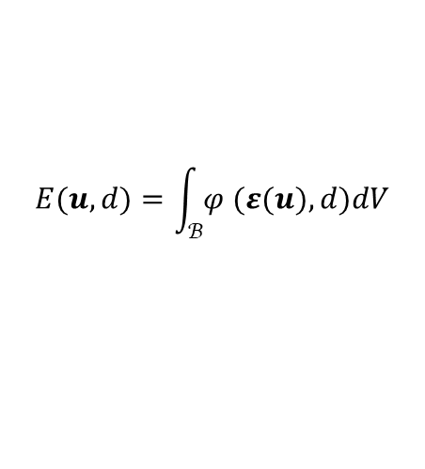
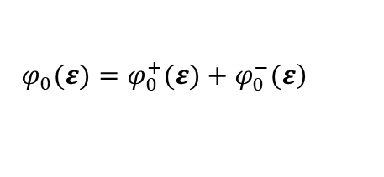
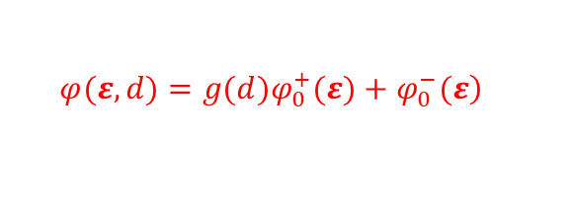
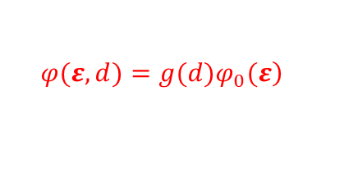
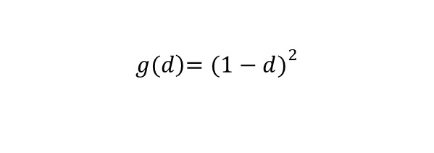
Energy functionals
Dissipation functional
$$D(d)=\int_{ℬ}{φ(d,∇d)dV}=\int_{ℬ}{g_{c}γ\left(d,∇d\right)dV}=\int_{ℬ}{g_{c}\left(\frac{1}{2l}d^{2}+\frac{l}{2}{\left|∇d\right|}^{2}\right)dV}$$
(11)
Free (stored) energy functional
$$E(u,d)=\int_{ℬ}{φ (ε(u),d)dV}$$
(12)
$$\left.φ_{0}(ε)=λ{\text{tr}}^{2}[ε]/2+μ\text{tr}[ε^{2}\right]$$
(13)
In which,
$$\left.φ(ε,d)=g(d)φ_{0}(ε\right)$$
with
$$g(d{\left)=(1−d)\right.}^{2}$$
(14)
Consider the unilateral effects
(i.e. the so-called anisotropic degradation in Miehe et al. 2010)
$$\left.φ(ε,d)=g(d)φ_{0}^{+}(ε)+φ_{0}^{−}(ε\right)$$
(15)
$$\left. φ_{0}(ε)=φ_{0}^{+}(ε)+φ_{0}^{−}(ε\right)$$
(16)

Slide 9
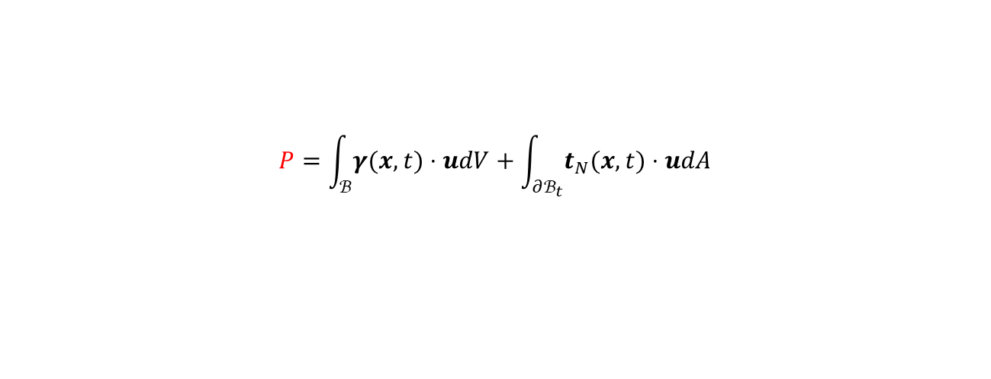
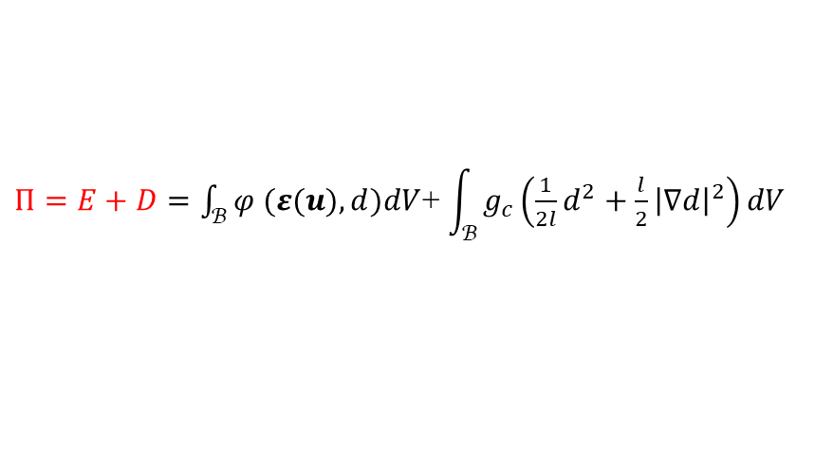
Internal energy functional
$Π=E+D=\int_{ℬ}{φ (ε(u),d)dV}$+ $\int_{ℬ}{g_{c}\left(\frac{1}{2l}d^{2}+\frac{l}{2}{\left|∇d\right|}^{2}\right)dV}$
(17)
Internal energy functional
Free energy functional
Dissipation functional
External power functional
$$P=\int_{ℬ}{γ(x,t)⋅udV}+\int_{∂ℬ_{t}}{t_{N}(x,t)⋅udA}$$
(18)
External power functional
Body force
Surface force

Slide 10
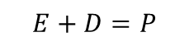
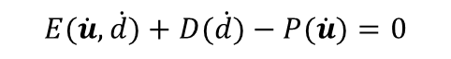
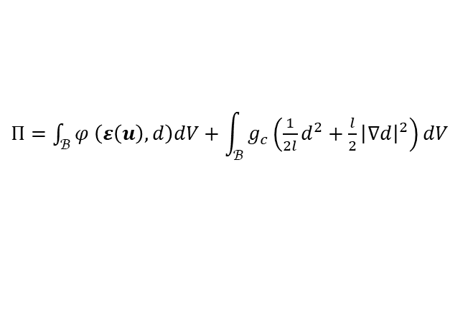
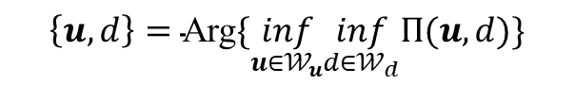
Miehe et al. 2010 VS Bourdin et al. 2000
Energy conservation
Energy minimization
$$E+D=P$$
$$\left\{u,d\right\}=\text{Arg}\{\inf_{u∈𝒲_{u}}\inf_{d∈𝒲_{d}}Π(u,d)\}$$
$$E(\dot{u},\dot{d})+D(\dot{d})−P(\dot{u})=0$$
Virtual power principle
Coupled balance equations
with
$Π=\int_{ℬ}{φ \left(ε\left(u\right),d\right)dV+}$ $\int_{ℬ}{g_{c}\left(\frac{1}{2l}d^{2}+\frac{l}{2}{\left|∇d\right|}^{2}\right)dV}$

Slide 11
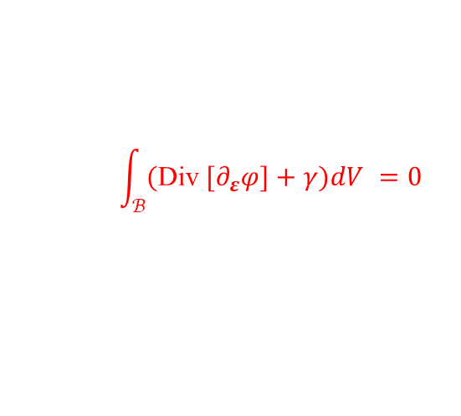

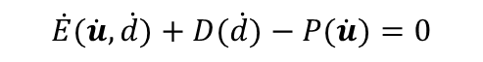
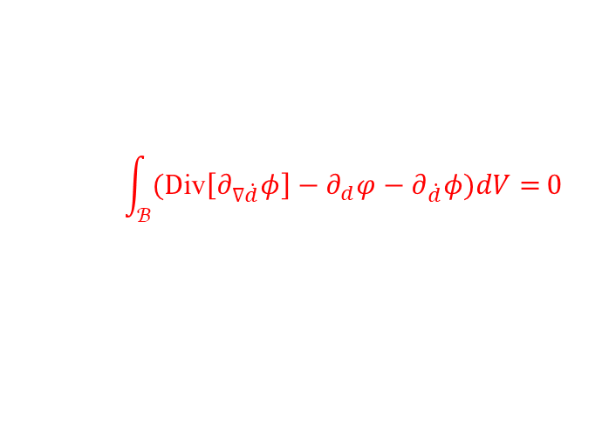
Balance equations
Energy conservation
$P=E+D=\int_{ℬ}{φ (ε(u),d)dV}$+ $\int_{ℬ}{g_{c}\left(\frac{1}{2l}d^{2}+\frac{l}{2}{\left|∇d\right|}^{2}\right)dV}$
(19)
External power functional
Free energy functional
Dissipation functional
$$\dot{E}(\dot{u},\dot{d})+D(\dot{d})−P(\dot{u})=0$$
(20)
$$\int_{ℬ}{\text{(}\text{Div} [∂_{ε}φ]+γ})dV =0$$
Virtual power principle
(21)
$$\int_{ℬ}{\text{(}\text{D}\text{iv}\left[∂_{∇\dot{d}}φ\right]−∂_{d}φ−∂_{\dot{d}}φ)dV=}0$$

Slide 12




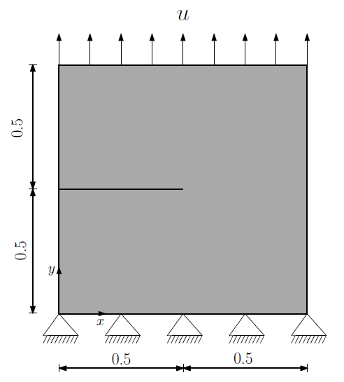
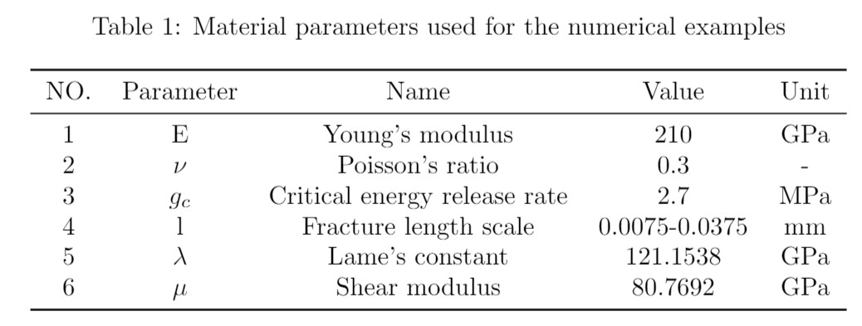
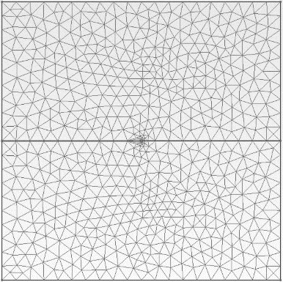
Numerical simulations: Mode Ⅰ
Workflow
Gmesh
Dolfin-convert
FEniCS
Paraview
(Miehe et al., 2010)
Fig.5 Geometry mesh and boundary conditions

Slide 13
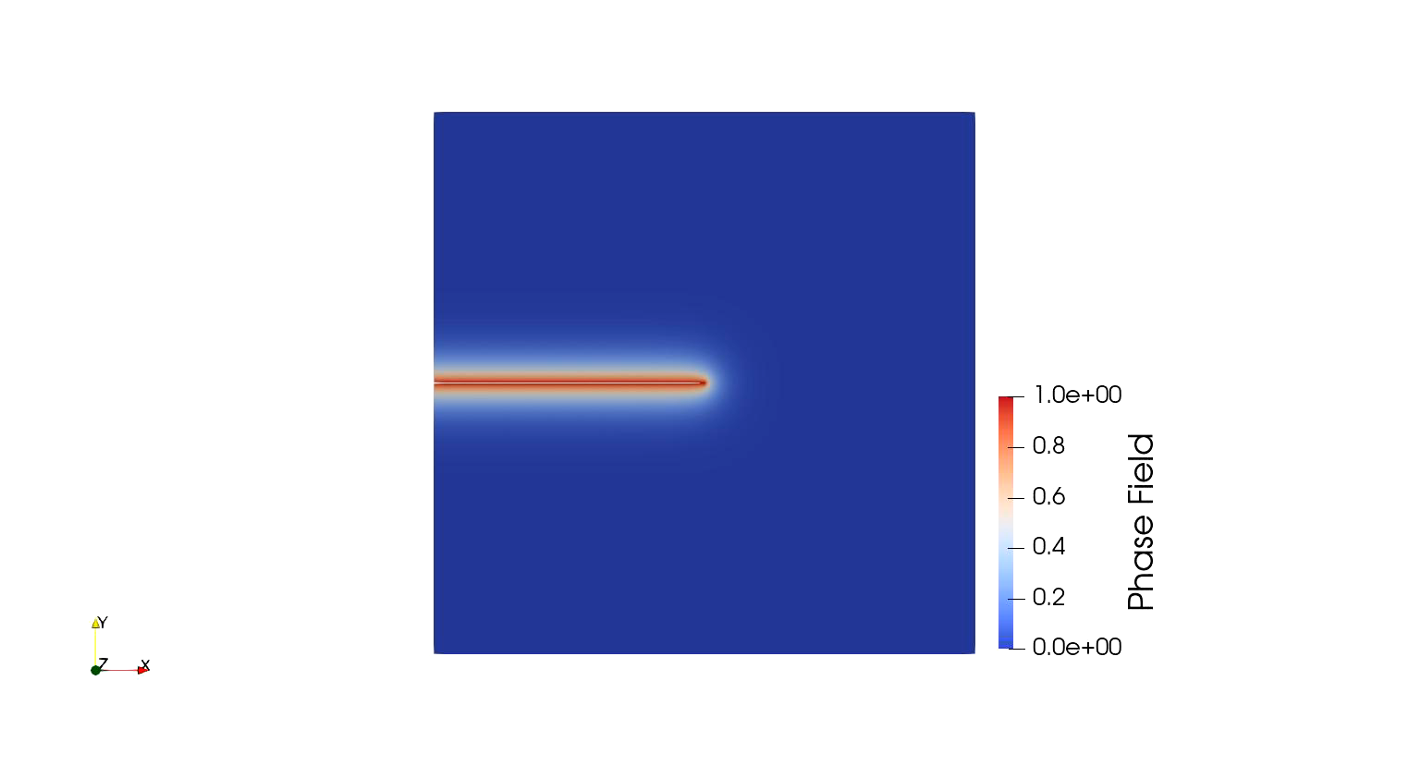
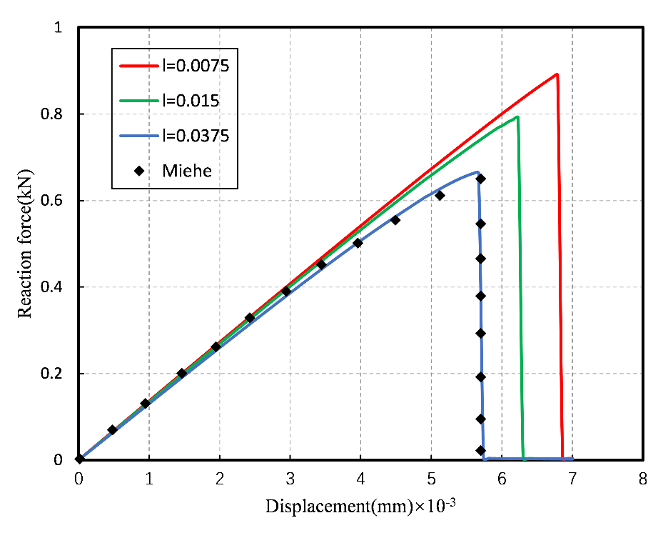
Numerical simulations: Mode Ⅰ
Fig.6 The evolution of phase field
Fig.7 Load versus displacement curve

Slide 14
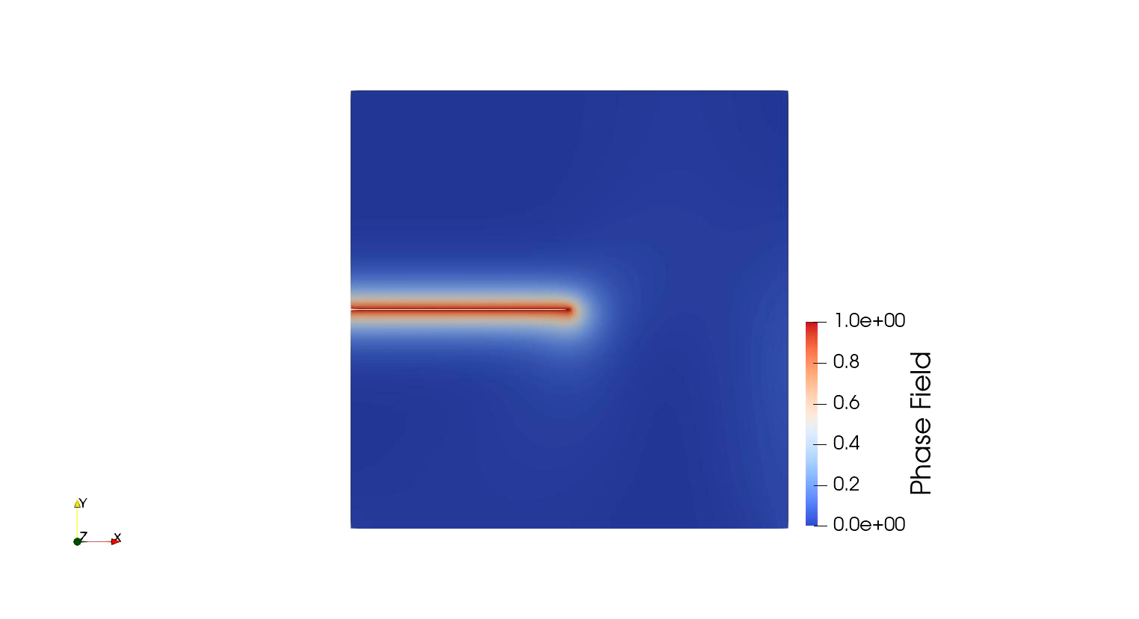
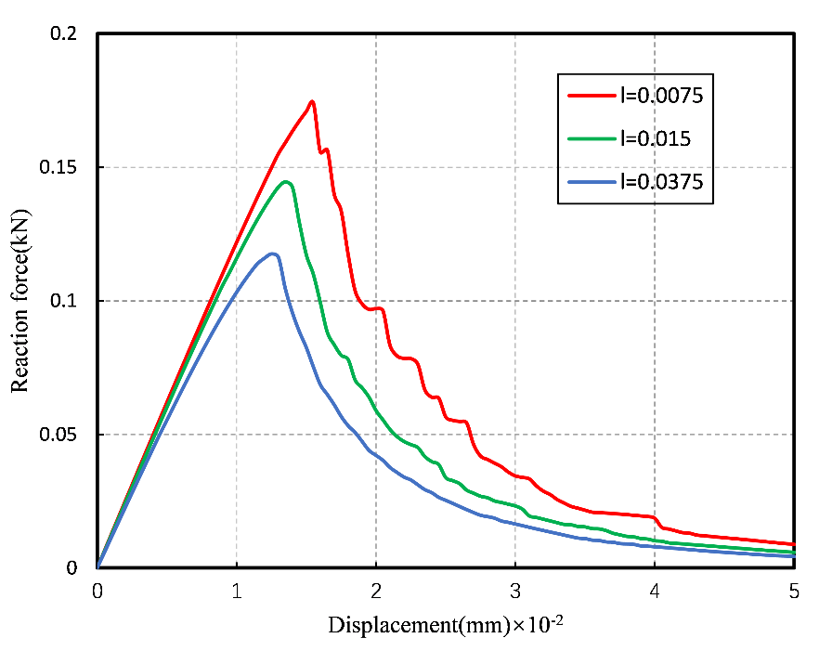
Numerical simulations: Mode Ⅱ
Fig.8 The evolution of phase field
Fig.9 Load versus displacement curve
Notes:
Ffffff

Slide 15
03
PART
Phase field modeling of fracture by considering the hydromechanical coupling

Slide 16
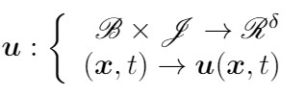
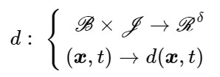
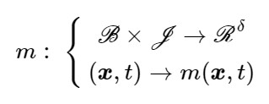
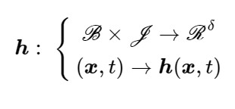
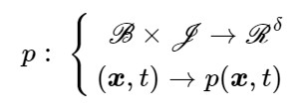
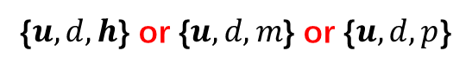
Thermodynamics: state variables
Solid phase
and
Fluid phase
or
or
State variables
{$u,d,h$} or {$u,d,m$} or {$u,d,p$}
《Hydraulic fracture in poro-hydro-elastic media》Steffen and Miehe,2016

Slide 17
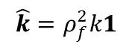
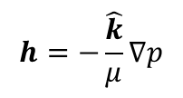
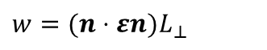
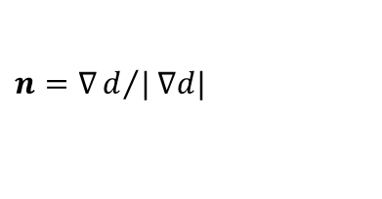




Fluid flow in geomaterials
Darcy flow
$$h=−\frac{\hat{k}}{μ}∇p$$
with
$$\hat{k}=ρ_{f}^{2}k1$$
(22)
(23)
$$\dot{m}=−Div[h]$$
Fluid flow in cracks
$\hat{k}(ε,d)={\hat{k}}_{Darcy}+d^{ε}{\hat{k}}_{Crack}$ (24)
(Miehe, 2016)
$n=∇d/|∇d|$
with
$w=(n⋅εn)L_{⊥}$
${\hat{k}}_{Crack}(ε,d)=ρ_{f}^{2} (\frac{w^{2}}{12\overline{η}}−{\hat{k}}_{Darcy})(1−n⊗n$)
$\hat{k}(d)={\hat{k}}_{Darcy}\exp\left(αd\right)$ (25)
(Pillai et al., 2018)

Slide 18




Numerical simulations without damage: Darcy flow-Drained test (free flux boundary)
Fluid flux: non-standard function space H (div, $ℬ$)
e.g. Raviart –Thomas element (RT element)
Brezzi-Douglas-Marini elememt (BDM element)
Fig.10 Free flux boundary
Fig.11 Flux evolution
Fig.12 Pressure evolution

Slide 19



Numerical simulations without damage : Darcy flow-Undrained test (fixed flux boundary)
:
Fig.13 Fixed flux boundary
Fig.14 Flux evolution
Fig.15 Pressure evolution

Slide 20






Phase field modeling-Hydromechanical coupling: Energy functional
Free (stored) energy functional
Solid part
Contribution of saturated skeleton
$$E(u,d,m)=\int_{ℬ}{φ_{bulk} \left(ε\left(u\right),d\right)dV+}\int_{ℬ}{φ_{fluid} \left(ε\left(u\right),m\right)dV}$$
$$\left.φ_{0}(ε)=λ{\text{tr}}^{2}[ε]/2+μ\text{tr}[ε^{2}\right]$$
$=\int_{ℬ}{\left.g(d)φ_{0}(ε\right)dV+}\int_{ℬ}{M/2\left[be−m/ρ_{f}\right]dV}$ (26)
with
$$g(d{\left)=(1−d)\right.}^{2}$$
Dissipation functional
Solid part
Contribution of saturated skeleton
$$D(u,d,h)=\int_{ℬ}{φ_{bulk}(d,∇d)dV}{+\int_{ℬ}{{\int{φ_{fluid} (h;ε,d)}dt}_{ }}dV}_{ }$$
$=\int_{ℬ}{g_{c}\left(\frac{1}{2l}d^{2}+\frac{l}{2}{\left|∇d\right|}^{2}\right)dV}$ +$\int_{ℬ}{{\int{\frac{1}{2}h⋅{\overset{^}{k}}^{−1}(ε,d)⋅h}dt}_{ }}dV$ (27)

Slide 21


Internal energy functional
Internal energy functional
Solid part of
free energy
Contribution of saturated
skeleton to free energy
$Π=E+D=\int_{ℬ}{φ (ε(u),d)dV}$+ $\int_{ℬ}{\frac{M}{2}[be−\frac{m}{ρ_{f}}]\text{dV}\text{+}}$
$\int_{ℬ}{g_{c}\left(\frac{1}{2l}d^{2}+\frac{l}{2}{\left|∇d\right|}^{2}\right)dV}$+ $\int_{ℬ}{{\int{\frac{1}{2}h⋅{\overset{^}{k}}^{−1}(ε,d)⋅h}dt}_{ }}dV$ (28)
Solid part of
dissipation
Contribution of saturated
skeleton to dissipation
Energy minimization
$\left\{u,d,h\right\}=\text{Arg}\{\inf_{u∈𝒲_{u}}\inf_{d∈𝒲_{d}}\inf_{h∈𝒲_{h}}Π(u,d,h)\}$ (29)

Slide 22

External power functional
Mechanical part
Fluid part
$P(u,h)=P_{ext}^{g,t}(u)+$ $P_{ext}^{g,μ}(h$)
$\int_{ℬ}{γ(x,t)⋅udV}+\int_{∂ℬ_{t}}{t_{N}(x,t)⋅udA}$
+ $\int_{ℬ}{\int{g(\text{1}+∇u)⋅hdtdV}}−\int_{∂ℬ^{μ}}{\int{\overline{μ}hdt}dA}$ (30)
Gravity forces acting
on the fluid
Fluid mass transport
across the surface

Slide 23

Energy conservation
Contribution of saturated skeleton to free energy
External power functional
Solid part of
free energy
$P=E+D=\int_{ℬ}{φ (ε(u),d)dV}$+ $\int_{ℬ}{\frac{M}{2}[be−\frac{m}{ρ_{f}}]dV\text{+}}$ $\int_{ℬ}{g_{c}\left(\frac{1}{2l}d^{2}+\frac{l}{2}{\left|∇d\right|}^{2}\right)dV}+\int_{ℬ}{{\int{\frac{1}{2}h⋅{\overset{^}{k}}^{−1}(ε,d)⋅h}dt}_{ }}dV$ (31)
Solid part of
dissipation
Contribution of saturated skeleton to dissipation

Slide 24




Balance equations
$$\frac{d}{dt}E\left(\dot{u},h,\dot{d} \right)+D\left(h,\dot{d} \right)−P\left(\dot{u},h\right)=0$$
(32)
$$\int_{ℬ}{(−Div{[}∂_{ε}φ]−(m_{0}+m)g)dV}=0$$
Virtual power principle
$$\int_{ℬ}{(∇[∂_{m}φ−g⋅(x+u)]+∂_{h}φ})dV=0$$
(33)
$$\int_{ℬ}{{(∂}_{d}φ−Div{[}∂_{∇d}φ]+∂_{d}φ)dV} =0$$

Slide 25




Numerical simulations
Mode Ⅰ
Mode Ⅱ
Fig.18 Load versus displacement curve in tension test
Fig.19 Load versus displacement curve in shear test
Fig.16 Phase field evolution in tension test
Fig.17 Phase field evolution in shear test

Slide 26


Numerical simulations: Hydraulic fracture
(Miehe and Steffen, 2016)
Fig.20 Geometry mesh of hydraulic fracture

Slide 27



Numerical simulations: Hydraulic fracture
Fig.21 The evolution of phase field
Fig.22 The evolution of flux
Fig.23 The evolution of displacement

Slide 28
Conclusions and perspectives
A primary study of the bibliography in phase field modeling
Preliminary theoretical research of the phase field modeling of fracture with the consideration of the hydromechanical coupling
Learning of the numerical implementation of the phase field models via FEniCS
First series of numerical results and corresponding interpretations.
A deep study/research of more physical hydromechanical models and their applications to the phase field modeling
Direct minimization of the total energy functional
Taking into account the unilateral effect
Consideration of the rock plasticity and probably that of the corresponding incremental variational principal.

Slide 29
THANKS FOR YOUR ATTENTION

